Slide 1



Animation movie Analysis 📽️
Name: Sahil C Dhiman
Batch: MIP-DA-05

Slide 2


What we will discuss?
Introduction
Identified KPIs
Insights
Conclusion

Slide 3
Introduction
We have analyzed the dataset based on the movies with different genres based on language, audience preferences and countries.
Nonetheless, we also have identified revenues from movies based on voting preferences, country-wise and genre.

Slide 4
Identified KPIs
1. Audience preferences
2. Revenue Analysis

Slide 5
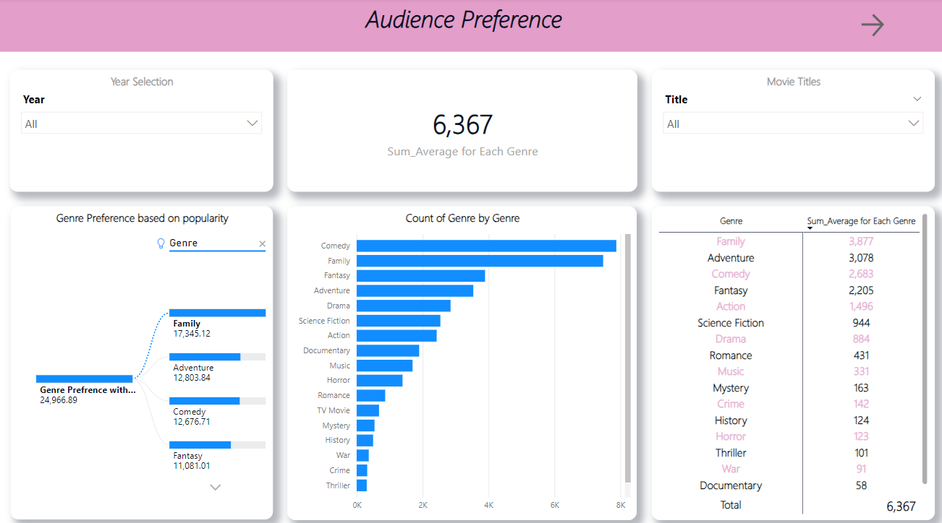
Insight 1: Audience Preference👥🎞️
The analysis starts from the year 2000 till 2023.
The drastic change in audience preference can be seen based on more vote counts, genre preferences based on popularity, and the count of the genre in which the movie is made.
The genre can be seen mainly based on family, comedy, adventure and fantasy.

Slide 6
Continue
Based on the analysis, the audience’s interest increased more from the start of the new decade to the film era.
Genres such as Family have 3,877 sum averages in the vote count and popularity of 17,345.12, which changes in the following years; however, it marks the first position.
Following it, Adventure with 3,078, comedy with 2,683 and Fantasy with 2,205, respectively.
Although action has lately become popular from the year 2016-2017 and marked the 5th position of interest among people.

Slide 7
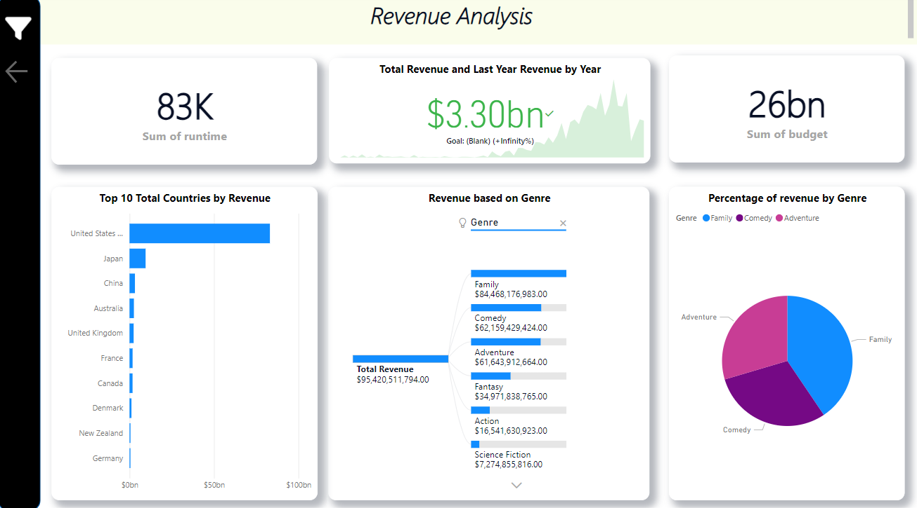
Insight 2: Revenue Preference💸
The analysis starts from the year 2000 till 2023.
The revenue calculated is a total of $3.30 billion, which includes the years starting from 1918 up until 2023.
The key metrics are analyzed based on the runtime and revenue compared to last year's revenue and thus can be modified based on the filters.

Slide 8
Continue
It is interesting to see in all the years, the United States positions itself as the top 1 country by revenue generated.
As we have discussed previously, genres such as Family position themselves to be most voted by people who hold a revenue of nearly $84,468,176,983.00, comedy with $62,159,429,424.00
Lets dive into more practical scenario by seeing the actual dashboard on Power BI.

Slide 9
Conclusion
In the project, we have analyzed the movie dataset based on the movies made under all sorts of genres specified by mentors.
We have seen two major KPIs and metrics based on each genre's audience preferences and revenue generated.
Based on this analysis, not only does the client get insights into it but also the decisions that can help run the movie business by keeping revenue intact and respecting audiences.

Slide 10

Thank you

